Slide 1



SAP Automated Sales Workflow System
Jaypee University of Information Technology
Department of Computer Science and Engineering and Information Technology
Major Project - II (18B19CI891) | AY 2024-25
End-Term Evaluation | May 16-17, 2025.
Group No.: G11C
Team Member (s)
Tanisha Chaubey (211312)
Supervisor (s)
Dr. Anita
Assistant Professor (SG)
CSE & IT

Slide 2
Outline
Introduction
Problem Statement
Objectives
Work Done (after Mid-Term Evaluation)
Project Design
Implementation
Experimental Results and Evaluation
Key Learnings
Future Work
Work Contribution and Attendance
Supervisor Interactions
References

Slide 3
Introduction
Developed a custom SAP Sales & Distribution portal for an automobile manufacturing company.
Aimed to automate and streamline sales processes such as inquiry creation, quotation handling, and order management.
Built using SAP ABAP Module Pool Programming with integration of ALV grids, Smartforms, and SAP workflow.
Role-based access provided for customers and admins with dedicated dashboards and actions.
Ensured real-time email communication, data consistency, and document generation within the SAP environment.

Slide 4
Problem Statement
The existing SAP setup lacked a centralized system for managing customer registration, order tracking, inquiries, and quotation handling. Many of these processes were manual, leading to delays, data inconsistencies, and increased workload for users.
There was no provision for automated email communication, customer profile updates, or dynamic order dashboards. Admins had limited tools to process and monitor orders efficiently, making the overall sales workflow time-consuming and less transparent. This highlighted the need for a user-friendly, role-based application to automate and streamline key sales functions within SAP.

Slide 5
Objectives
To design and implement a custom SAP module pool application for managing end-to-end sales and distribution processes.
To enable customers and admins to perform actions such as registration, inquiry creation, order tracking, and quotation management through role-based dashboards.
To automate email notifications and document generation using SAP Workflow and Smartforms.
To improve data consistency, user interaction, and processing efficiency by integrating ALV grids and validation logic within custom SAP screens.

Slide 6
Work Done (after Mid-Term Evaluation)
Added a new Profile Update Screen (Screen 500) allowing customers to modify their personal details securely.
Implemented workflow-based email triggers for all five key events: Inquiry Created, Follow-Up Requested, Order Canceled, Quotation Accepted, and Rejected.
Integrated Smartforms for generating dynamic quotations and invoices in PDF format, sent via email.
Developed admin-side logic to handle quotation creation, order fulfillment, and partial stock validations.
Finalized all screen validations, ALV selection logic, and backend integration to ensure smooth navigation and accurate data processing.

Slide 7
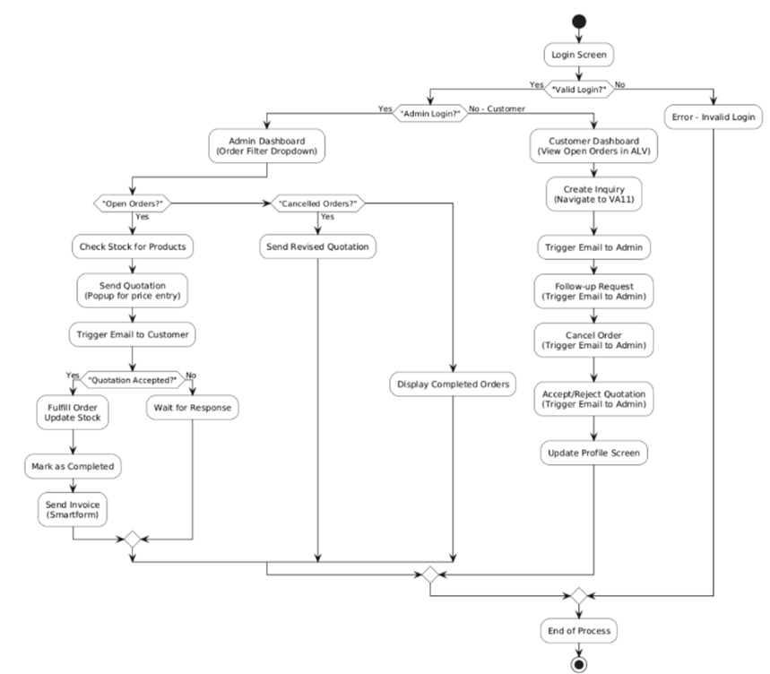
Project Design
Figure 1: Flowchart of the Project

Slide 8
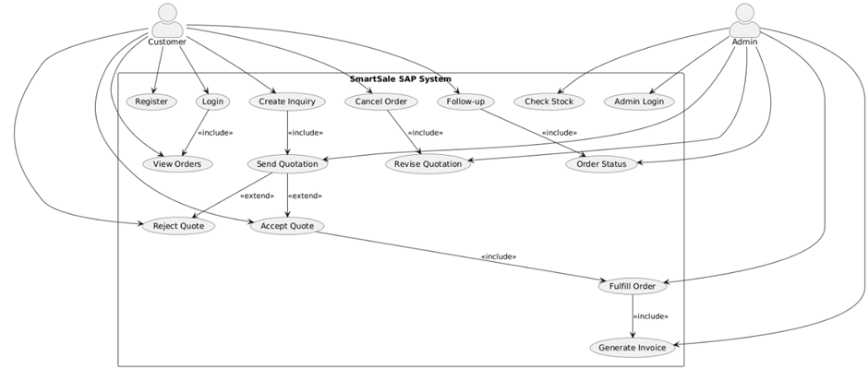
Project Design (cont…)
Figure 2: Use Case Diagram

Slide 9
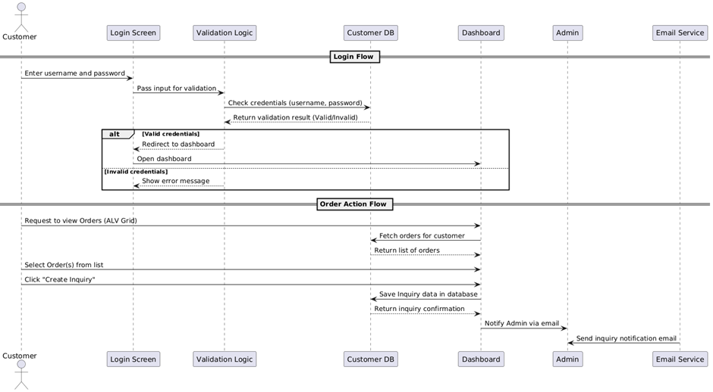
Project Design (cont…)
Figure 3: Sequence Diagram

Slide 10
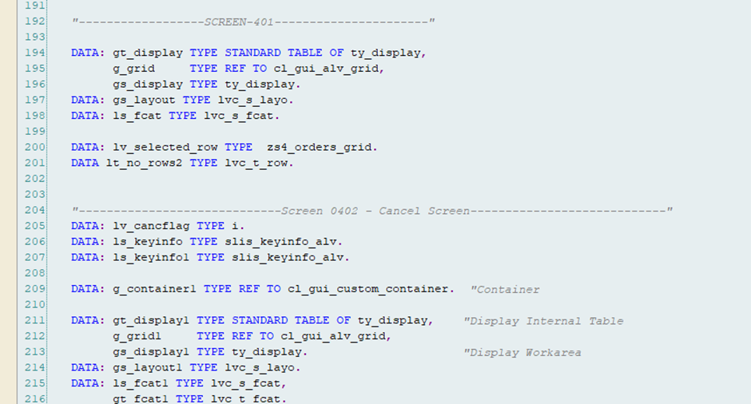
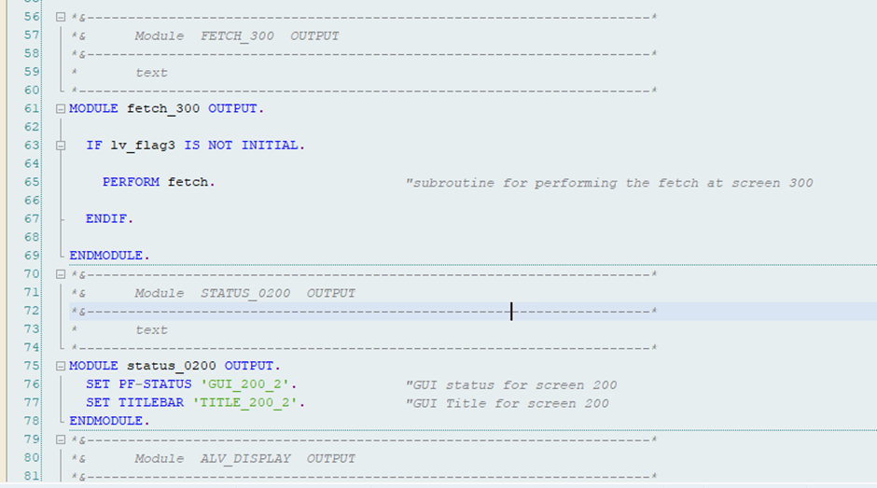
Implementation
Figure 4: Data Declaration for different screens
Figure 5: PBO (Process Before Output) Module for Screen 1.

Slide 11
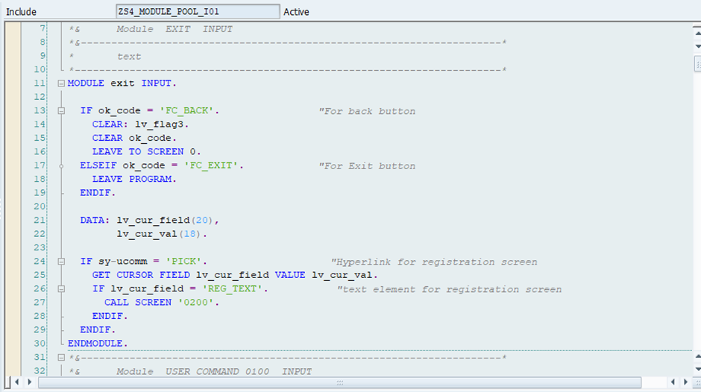
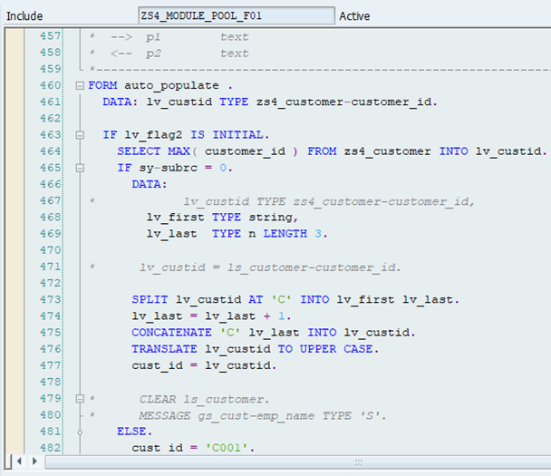
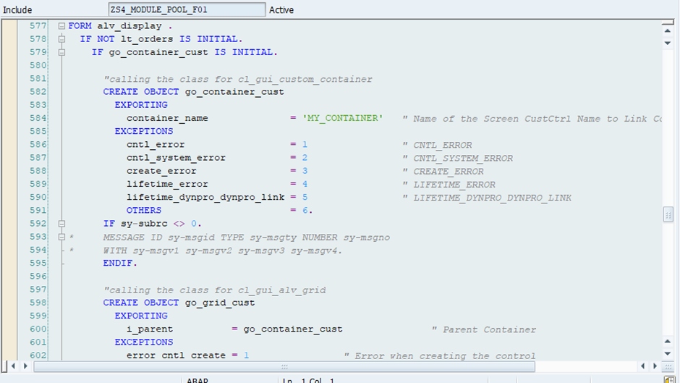
Implementation (cont…)
Figure 6: PAI (Process After Input) Module for Screen 1.
Figure 8: Form-Routines Module for Auto Populate the customer ID.
.
Figure 7: Form-Routines Module for ALV Display.

Slide 12
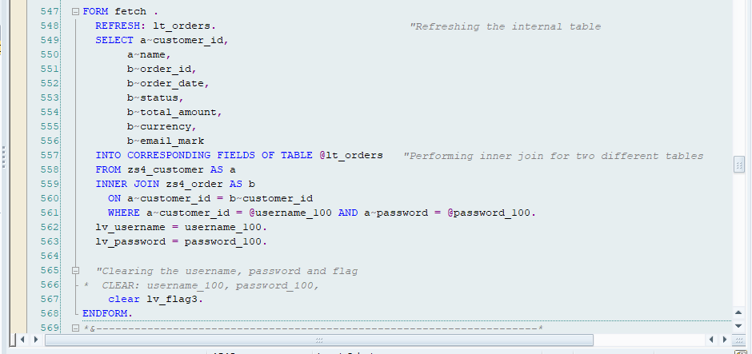
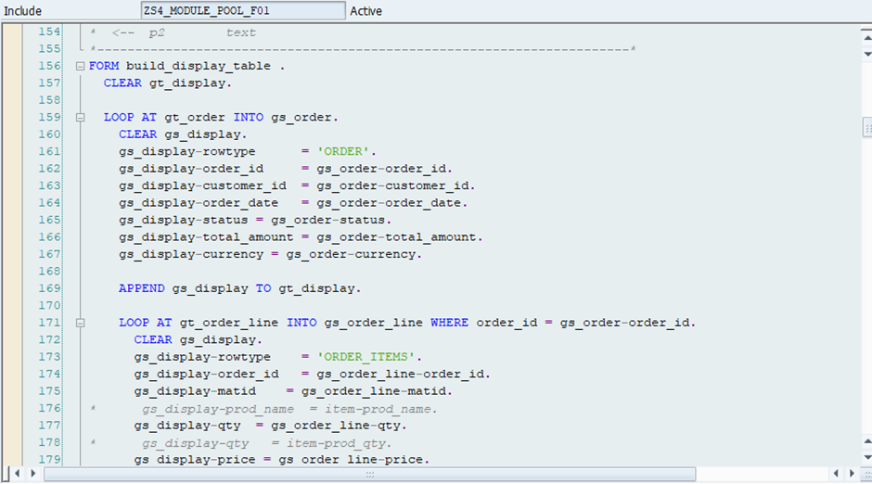
Implementation (cont…)
Figure 9: Form-Routines Module for Fetching Data.
Figure 10: Form-Routines Module for Build_Display_table.

Slide 13
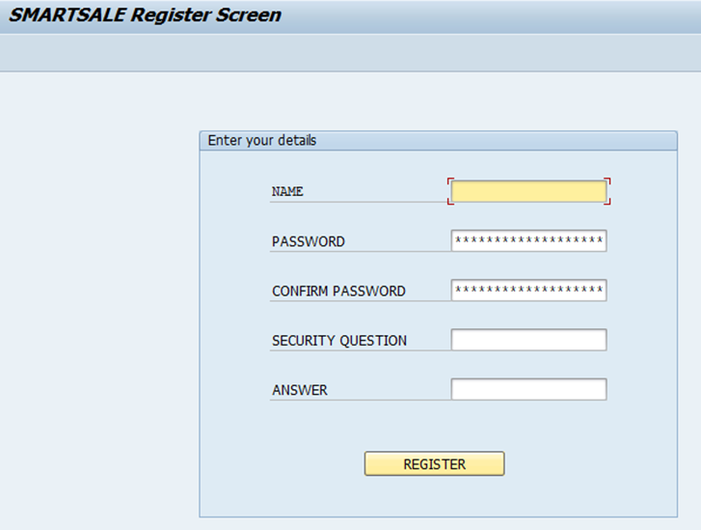
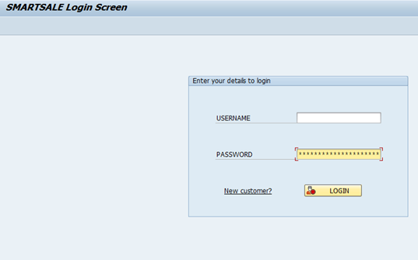
Experimental Results and Evaluation
Created and tested five custom tables for managing customers, products, inquiries, quotations, and order statuses.
Verified CRUD operations and data flow using module pool screens, ALV grids, and BDC uploads.
Smartforms and CL_BCS email triggers worked accurately for all workflow events.
Figure 11: Project’s Login Screen
Figure 12: New Registration Screen

Slide 14
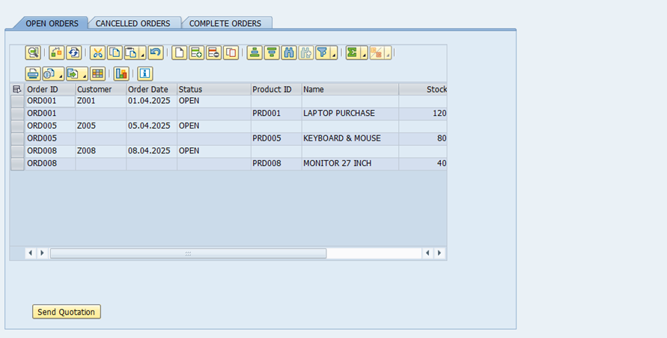
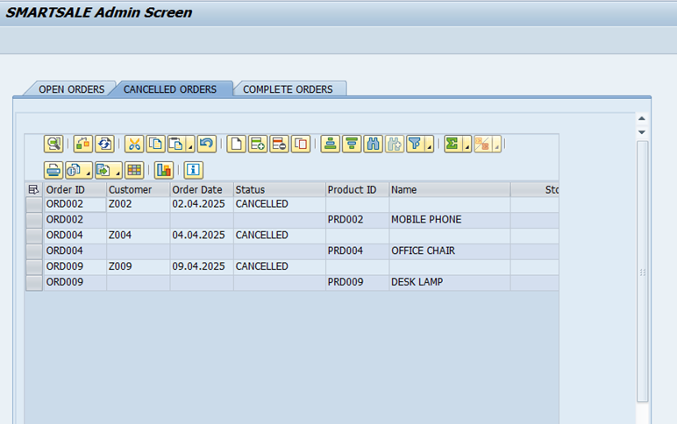
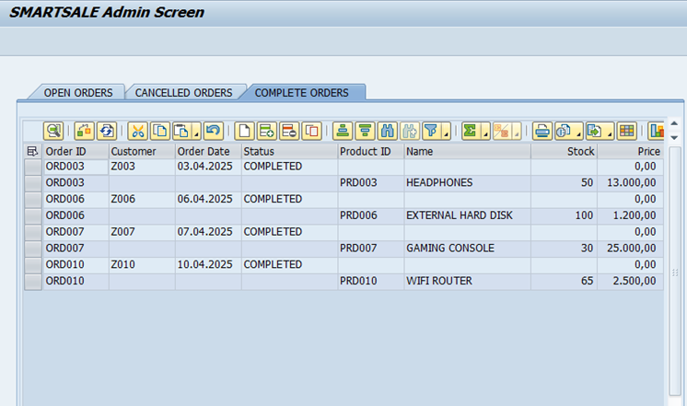
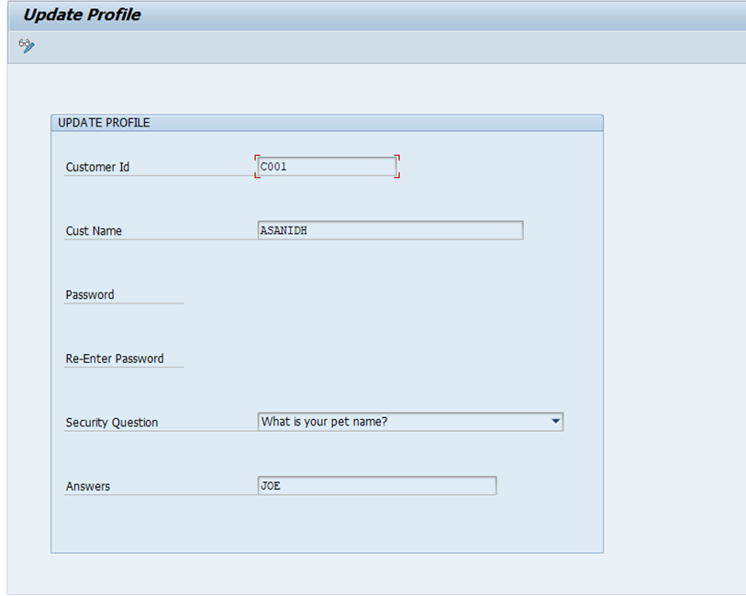
Experimental Results and Evaluation (cont…)
Figure 13: Admin Screen with Open Orders
Figure 14: Admin Screen with Cancelled Orders
Figure 15: Admin Screen with Completed Orders
Figure 16: Update Profile Screen

Slide 15
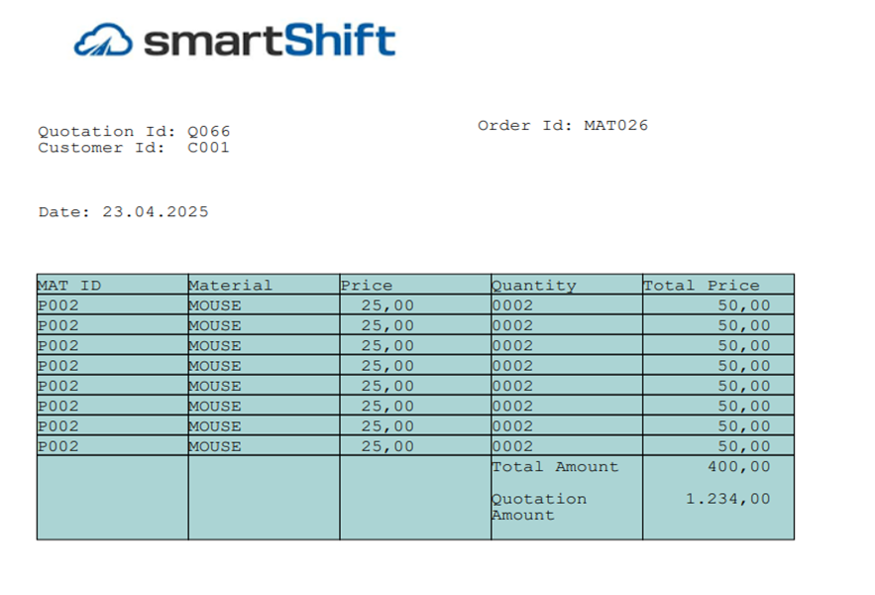
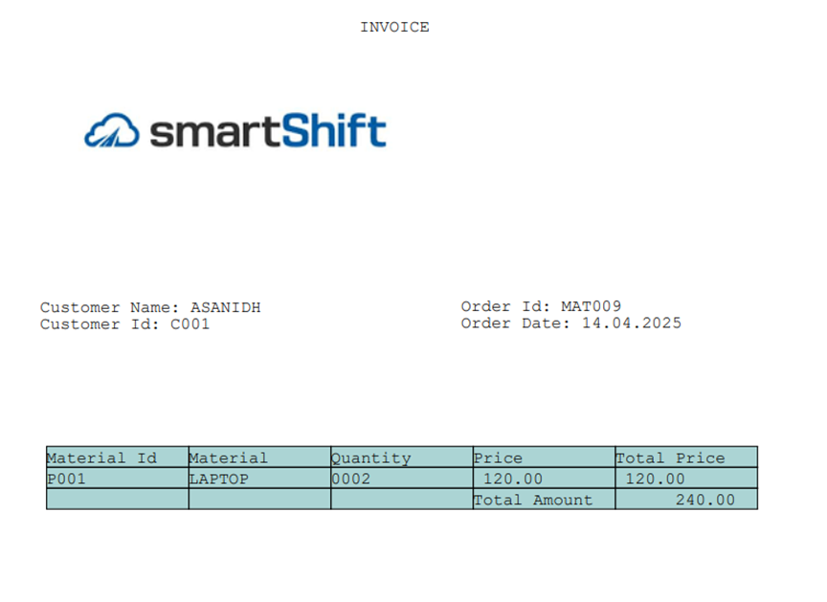
Experimental Results and Evaluation (cont…)
Figure 18: Smartforms Invoice Details
Figure 17: Smartforms Quotation Details

Slide 16
Key Learnings
Gained hands-on experience in SAP Module Pool Programming, including dynpro design, PBO/PAI logic, and screen navigation.
Learned to create and manage custom database tables using the Data Dictionary (SE11) for structured backend data handling.
Understood the implementation of SAP Workflow and CL_BCS for real-time email communication based on user actions.
Explored the usage of ALV Grids for interactive data display and selection-based operations in customer/admin dashboards.
Developed skills in Smartform design and integration, enabling automated document generation and PDF emailing

Slide 17
Future Work
Future enhancements can include integrating the application with SAP Fiori or UI5 to provide a more modern, mobile-friendly user experience. Implementing role-based authorization will help ensure secure access control based on user roles, improving the system's overall reliability.
Additional improvements may involve adding reporting and analytics for better business insights and expanding communication with SMS or push notifications. Optimizing the application for larger data volumes will also help scale it for broader enterprise use.

Slide 18
Work Contribution and Other Details
Roll No. |  | Start Date (dd/mm/2025) |  | Organization & Location | Work Mode (Online/Offline) | Work Nature (Tech./Non-Tech.) | Work Domain
211312 |  | 10/03/2025 |  | smartShift & Bangalore | Offline | Tech. | SAP ABAP
GitHub Repository URL:
Work Contribution (provide week-wise work details)
Week 1 | 10/03/2025 to 15/03/2025 |  | Understood project scope and finalized requirements. Created custom tables for customer, product, inquiry, and quotation using SE11. Implemented primary keys, field validations, and foreign key relationships.
Week 2 | 17/03/2025 to 22/03/2025 |  | Designed and created the login and registration screens using Screen Painter and Flow Logic. Implemented logic for user authentication and registration validation. Developed auto ID generation logic for Customer ID in registration.
Week 3 | 24/03/2025 to 29/03/2025 |  | Created the customer dashboard screen displaying open orders using ALV Grid. Learned ALV field catalog, layout customization, and row selection methods. Integrated order selection and Create Inquiry button functionality.
Week 4 | 31/03/2025 to 05/04/2025 |  | Developed functionality for Follow-Up and Cancel buttons with row-wise selection logic in ALV. Implemented internal table processing to update order statuses in the database. Created a custom module to trigger workflow event for selected actions.

Slide 19
Work Contribution and Other Details (cont…)
Work Contribution (provide week-wise work details)
Week 5 | 07/04/2025 to 12/04/2025 | Built the admin dashboard with dropdown filters for order status (Open, Cancelled, Completed). Designed hierarchical display of orders with multiple line items. Implemented logic for stock checking and quotation creation using popup screen.
Week 6 | 14/04/2025 to 19/04/2025 | Integrated Smartforms for quotation generation in PDF format. Triggered quotation email to customer using CL_BCS.
Week 7 | 21/04/2025 to 26/04/2025 | Created logic for quotation acceptance/rejection by customer with status update. Handled event-triggered email notification to admin team on each action. Designed invoice Smartform to generate and email final bill after order completion.
Week 8 | 28/04/2025 to 03/05/2025 | Added Screen 500 for profile update functionality post customer login. Enabled modification of customer name, password, and security answer with validations. Updated changes directly in the ZCUSTOMER_DETAILS table after saving.
Week 9 | 05/05/2025 to 10/05/2025 | Performed full system testing and validated email and Smartform flows. Debugged ALV selections, workflows, and screen navigation.
Week 10 | 12/05/2025 to 17/05/2025 | Finalized complete application workflow from inquiry creation to invoicing. Compiled screenshots for project documentation and demonstration. Prepared the project report, completed PPT, and updated weekly contributions.

Slide 20
Supervisor Interactions (as mentioned in weekly log)
No. of Meetings with Supervisor:
Week No. | Duration | Remarks (as mentioned in the weekly log) | Incorporated (Yes/No)
1. | 10/03/2025 To 15/03/2025 | • Finalize custom tables and relationships • Focus on project-specific SD flow • Avoid redundant fields | Yes
2. | 17/03/2025 To 22/03/2025 | • Keep screen layouts clean and SAP-standard • Ensure validation for login • Avoid hardcoding credentials | Yes
3. | 24/03/2025 To 29/03/2025 | • Test ALV data fetch and selection • Maintain status codes for orders • Handle empty datasets properly | Yes
4. | 31/03/2025 To 05/04/2025 | • Enable workflow for Follow-Up and Cancel • Create event logs for debugging • Display user messages | Yes
5. | 07/04/2025 to 12/04/2025 | • Design dropdown-based order filtering • Validate stock before quotation • Use popups for input clarity | Yes

Slide 21
Supervisor Interactions (cont…)
Week No. | Duration | Remarks (as mentioned in the weekly log) | Incorporated (Yes/No)
6. | 14/04/2025 to 19/04/2025 | • Design Smartforms for flexible layouts • Align form data with order structure • Enable PDF attachment in emails | Yes
7. | 21/04/2025 to 26/04/2025 | • Create accept/reject buttons • Update status correctly on response • Trigger invoice only after acceptance | Yes
8. | 28/04/2025 to 03/05/2025 | • Add new screen for profile update • Perform proper validations • Prevent unauthorized edits | Yes
9. | 05/05/2025 to 10/05/2025 | • Conduct full testing of all modules • Fix navigation and trigger bugs • Document test outcomes | Yes
10. | 12/05/2025 to 17/05/2025 | • Finalize report and presentation • Cross-check screenshots • Complete contribution and interaction logs | Yes

Slide 22
References
[1] SAP SE (2022). Smart Forms in SAP – Creating and Sending Documents. SAP Documentation. Available online: https://help.sap.com/viewer/product/SMARTFORMS
[2] B. R. Khan (2022). "Integrating SmartForms with Business Processes in SAP," International SAP Solutions Journal, vol. 6, no. 4, pp. 18–23.
[3] M. D. Srinivas (2022). "Designing Role-Based Login and Authentication Modules in SAP," International Journal of SAP Technologies, vol. 8, no. 1, pp. 34–39.
[4] H. Frank and T. Allgaier, SAP S/4HANA Sales Certification Guide (C_TS462_2021): Application and Configuration Preparation, SAP Press, 2021
[5] N. Singh, "Manual and Unit Testing Strategies in SAP-Based Projects," Journal of Enterprise Software Testing, vol. 7, no. 2, pp. 50–55, 2021.
[6] M. T. Smith, “Designing SAP Fiori UIs for SAP GUI Module Pool Applications: A Transition from Classical Dynpro to Modern UX,” in SAP UI/UX Developer Summit, Palo Alto, CA, USA, Sep. 2020.
[7] D. Obermeier, Efficient SAP Business Workflow: Practical Solutions for Workflow Automation, SAP Press, Rheinwerk Publishing, 2020.

Slide 23
References (cont…)
[8] V. N. Kumar and S. Rathi, “Improving Customer Registration and Authentication in SAP ERP Using Secure ABAP Techniques,” International Journal of Engineering Research and Applications (IJERA), vol. 10, no. 2, pp. 51–56, Feb. 2020.
[9] B. T. Robinson . "SAP Email Integration via ABAP and SMTP Configuration," International Journal of SAP Practices, vol. 5, no. 1, pp. 12–17, 2020.
[10] A. Bose . Custom SAP Applications: Real-World Development Using ABAP, SAP Press, Boston, MA. 2020.
[11] C. C. Smith, Customizing SAP S/4HANA: Tools and Techniques for Tailoring the System to Meet Business Requirements, SAP Press, Boston, MA, USA, 2020.
[12] R. Deshmukh . "ABAP-Based Email Automation Using SAP Workflows," SAP Workflow Insights, vol. 7, no. 4, pp. 10–15, 2020.
[13] V. Mohan, “Email Notifications in SAP ERP Systems: Enhancing Customer Communication in SD Module Through SMTP Integration,” in Proc. International Conference on Communications and Signal Processing (ICCSP), Chennai, India, Apr. 2020, pp. 338–342.

Slide 24
References (cont…)
[14] G. Fritsche . ABAP Objects: ABAP Programming in SAP NetWeaver and SAP S/4HANA Environments, SAP Press, Boston, MA. 2019.
[15] S. K. Jain and D. Bhattacharya, “Risk Assessment and Mitigation in SAP ERP SD Module Implementation Projects,” International Journal of Management and Applied Science (IJMAS), vol. 5, no. 3, pp. 89–94, Mar. 2019.
[16] S. B. Pandey and M. P. Gupta, “Digital Transformation of Sales and Distribution Systems Using SAP ERP in Mid-Sized Firms,” Journal of Enterprise Information Management, vol. 32, no. 5, pp. 807–825, 2019.
[17] B. Gupta and K. Varma, “Implementation of SAP ERP Order to Cash (O2C) Cycle: A Case Study in Automobile Sector,” International Journal of Engineering and Advanced Technology (IJEAT), vol. 8, no. 5, pp. 1453–1458, Jun. 2019.

Slide 25

Thanks.

